Slide 1
British Airways
Exploratory data analysis
And
Predictive modelling

Slide 2
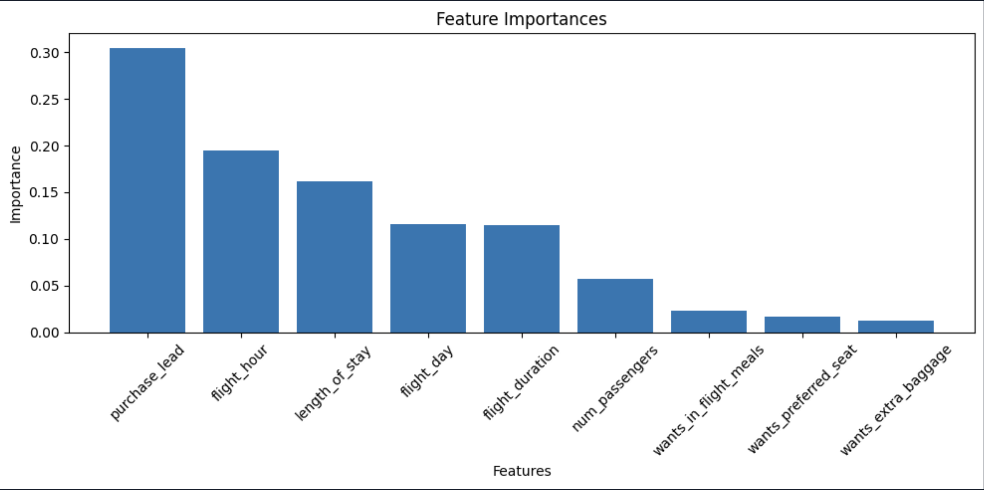
Model Accuracy And Feature Importance
Using all features which are in numeric form , Implemented Random Forest for this data and got 84.88% accuracy. Which is good for predictive models.
purchase_lead, flight_hour and length_of_stay are dominating features that have more dependency to achieve more accuracy.
Cross-Validation Accuracy: 0.64 +/- 0.22 which states that an accuracy of 64% with a standard deviation of 0.22. This indicates that the model achieved an average accuracy of approximately 64% across the 5 folds, with some variability in performance

